Slide 1
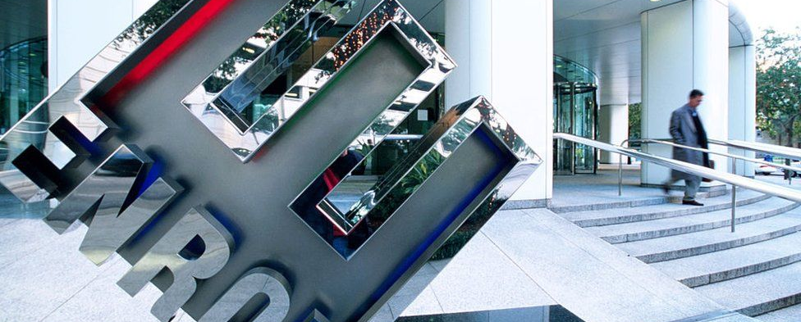
Enron Case Study
FITE7410 Financial Fraud Analytics [Section 1A, 2021]
Chung, Ching Justin (); He, Zhihao (); Ho, Kam Tim (3035754040); Wang, Guanyu (); Xie, Xiaohan ()

Slide 2
Content
Background and Objective (history, involved parties, impacts)
Explore the data: EDA
Clean and Transform the data
Feature Engineering and Sampling
Data Modelling
Evaluation (including how to improve our model performance)
Suggestions and Further Improvements (regulators [Sarbanes-Oxley Act(2002)], corporate, external auditors perspectives)
Notes:
In the year 1985, with the merger of two companies, Huston Natural Gas (HNG) and InterNorth, Enron was born. It was regarded as one of the best energy and natural gas companies in the world. And for six consecutive years was named "America's Most Innovative Company" by Fortune Magazine. Kenneth Lee Lay was the chairman and CEO of the company. Later, Jeffery Skilling was appointed as the new CEO while Ken Lay maintained his position as the chairman.
However, what looked like a dream company from the outside was actually crumbling under the weight of billions of dollars of debts and failed project from within. These debts and losses were skillfully, willfully and systematically swept under the rug through accounting and auditing frauds over a sustained period of time. Eventually, Enron filled for bankruptcy in the year 2001 wiping out $78 billion in stock market value. It has since been known as the biggest case of corporate fraud in U.S history ever.
Post the federal investigation of Enron Scandal, confidential information regarding the case crept into public domain. This information contained 600,000 emails generated by 158 enron employess and came to be known as the Enron Corpus.
My objective for this project is to use Machine Learning techniques to identify Persons of Interest from the data available from the Enron Corpus. A Person of Interest (POI) in this case is referred as person who was involved in the case.

Slide 3
Background
Conduct a meta-study of the chosen financial fraud case:
Understand the background and the case profile.
Identify the data sources.
Notes:
https://nbviewer.org/github/gautamjo/Udacity-Project-5-Intro-to-Machine-learning/blob/master/project_report.html

Slide 4
Objective
Identifying POI
Building fraud detection model

Slide 5
Details of Projects
Answer questions
Business Problem: The objective (e.g. identification of relationship, timeline analysis, fraud detection, etc)
Explore the data: Perform EDA (Exploratory Data Analysis) and explain the results.
Sampling: Describe the techniques or methods used for sampling.
Clean and transform the data: Describe the techniques or methods used for data pre-processing.
Data modeling: Develop a new financial fraud detection model.
Interpret and evaluate the model: Evaluate the performance.
Non-data analytic element: The risks and red flags of the case, other non-data analytic elements, suggestions.
Notes:
Background
Objective (identify POI and building fraud detection model)
Explore the data: EDA
Sampling
Clean and Transform the data
Data Modelling
Evaluation
Suggestions and Further Improvements

